Slide 1
PRU in Sitara Device
L3 Interconnect
ARM Subsystem
Programmable Real-Time Unit (PRU) Subsystem
Interconnect
PRU0 (200MHz)
PRU1 (200MHz)
PRU0 I/O
Cortex-A8
L3 Interconnect
PRU1 I/O
Shared RAM
Inst. RAM
DataRAM
Inst. RAM
DataRAM
L1 Instruction Cache
L1 Data Cache
L2 Data Cache
L4 Interconnect
INTC
Peripherals
Shared
Memory
Peripherals
Peripherals
GP I/O
Notes:
ARM + PRU + memories + peripherals = SoC
PRU works as a co-processor in system-level implementation, or
- PRU works independently

Slide 2
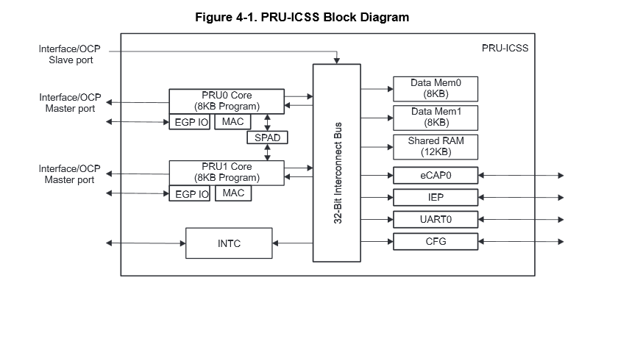
PRU – Programmable real-time ICSS – Industrial Communication Sub-system

Slide 3
PRU features
OCP – open core protocol – master port and slave port
2 PRUs, each had private memory
8K data
8K program
In between there Is scratch pad memory SPAD (3 banks, 30 32-bit registers)
Shared memory:
Shared ram 12k

Slide 4
PRU features
Interrupt Controller
64 input events
10 interrupt channels – hardware priorities
16 software events can be generated by 2 PRU
Two MII ports, one MDIO port
IEP (Industrial Ethernet peripheral) for harsh conditions (Fiber?)

Slide 5
PRU features
Enhanced Capture Module n(ECAP)
Memory is parity protected

Slide 6
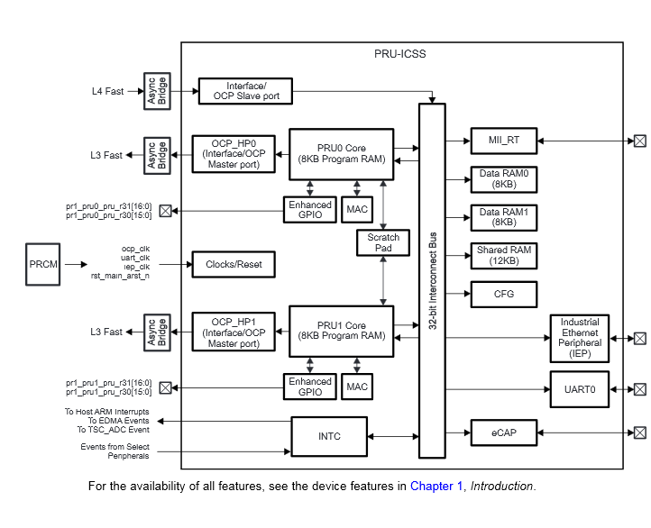
PRU-ICSS

Slide 7
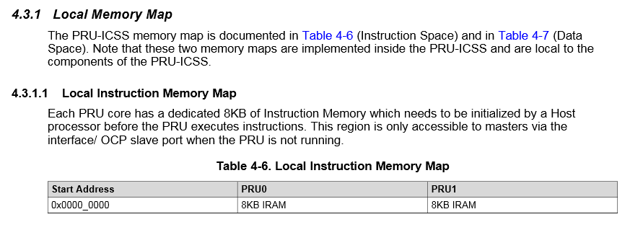
PRU Local memories – Program memory

Slide 8
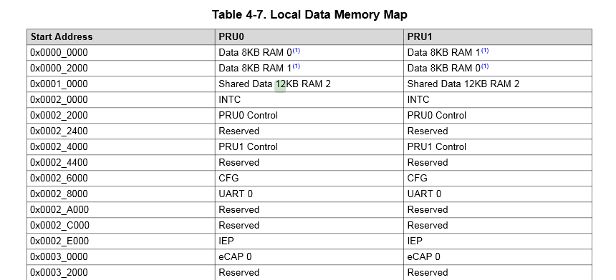
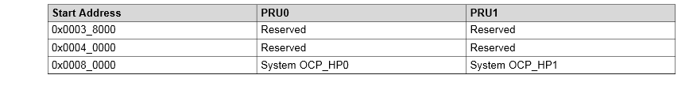
PRU Memory Map (local)
Each PRU sees his RAN at 0x000 0000 and the other one at 0x0000 2000

Slide 9
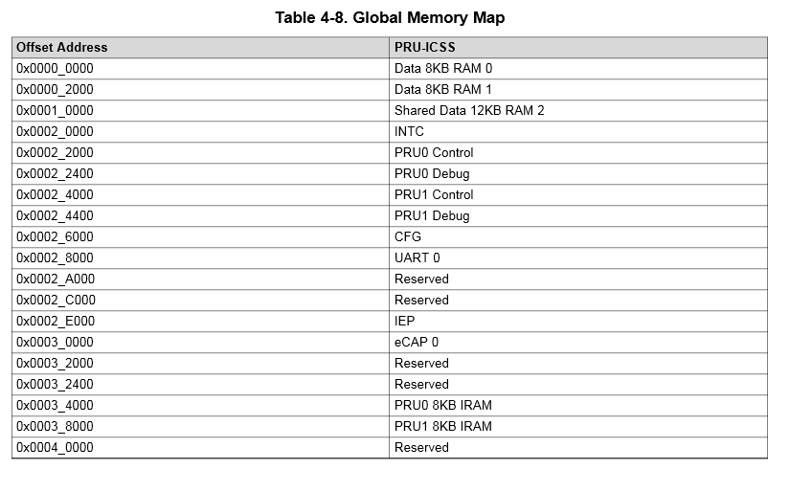
PRU Memory Map (Global)
This is the host view of the PRU memories

Slide 10
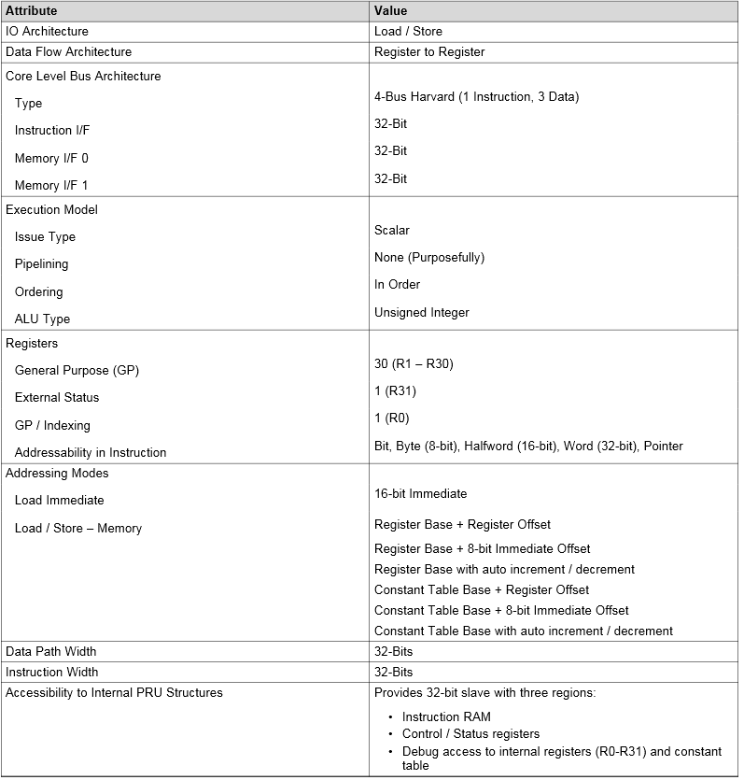
PRU Attributes

